Slide 1
Light Rail Patronage - with Percentile range Analysis
Elaiyaraj .P

Slide 2
Approach
Problem Statement
Objective
Data Summary
Exploratory Data Analysis
Data Wrangling
Feature Selection
Model
Result
Model Implementation
Recommendations

Slide 3
Problem Statement, Objective & Data Summary
Problem Statement:
Predict the daily total patronage figure (number of boardings) on the Light Rail Network in Canberra
Objective:
Predicting number of onboarding passengers with the lower (10 percentile) and Upper (90 percentile) range.
Data Summary:
To build the model, extracted the data from the provided site. The data begins from 5th Jan 2019 to till date.
I have used the date from 5th Jan 2019 to 25th June 2022 to develop the model, to predict the number of onboardings.

Slide 4
Exploratory Data Analysis & Data Wrangling
Dropped redundant features:
Dropped “My Way & Paper Ticket”(deriving the TOTAL column) variables, which are irrelevant / unnecessary for model building.
Deriving NEW variables:
I have derived 6 new variables from DATE columns. (For eg., Day, Week, Month, Quarter, Day of week and isWeekend variables). Created 7 days LAG on the TARGET shift to improvising the model accuracy.
Data Split:
I have segregated the data into 70 – 30 subset for Training and Testing of the models.

Slide 5
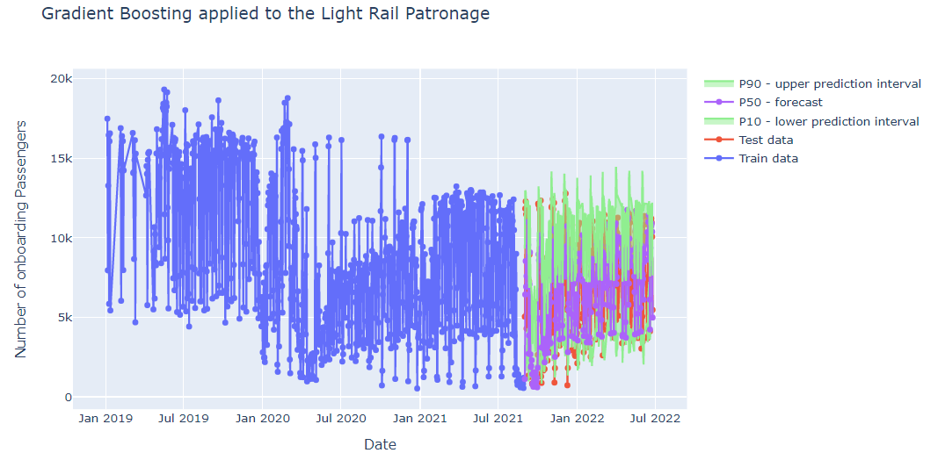
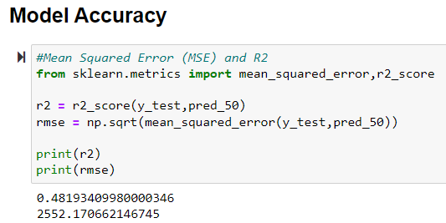
Feature Selection, MODEL'S and Result
Feature Selection:
Utilized "FEATURE_IMPORTANCE" function from ensemble techniques to find the important features, which will help us to build the best model.
Models & Result:
I have tested the data with multiple classification techniques to build the best model with high accuracy and finally chosen "GRADIENT BOOSTING“(with Quantile LOSS function) (48% accuracy) algorithm, which suits the data comparatively better than other models and providing the 10th, 50th and 90th Percentile range on the prediction.

Slide 6
Model Implementation and Recommendation
Model Implementation:
Implemented the trained "GRADIENT BOOSTING“ (with Quantile LOSS function) algorithm model in OUT OF TIME validation dataset (for next 30days – from 26th June) and mapped the responses (10, 50 & 90 Percentile range).
Submission:
I have mapped the response with OUT of TIME validation dataset and exported into CSV file.

Slide 7
THANK YOU

